Slide 1
Sensitivity Analysis
Jeehyun Lee
School of Mathematics and Computing
Yonsei University

Slide 2
Objectives
Conduct sensitivity analysis to explore changes in results when input parameters are varied
One-way and multi-way sensitivity analysis
Methods for sensitivity analysis
Grid search
Random sampling
Latin hypercube sampling
Representing results Histograms and tornado graphs

Slide 3
Sensitivity Analysis
Input parameters
Transmission probability
Duration of infection
Duration of immunity
Results
Incidence
Prevalence
Deaths
MODEL
Input parameters to a model are uncertain. To what extent does uncertainty in these parameters affect results?
This depends on two things:
The magnitude of uncertainty around each parameter
How important each parameter is in influencing the results
(Parametric) sensitivity analysis explores the change in results when input parameters are varied
Notes:
Input parameters to a model are inherently uncertain.
It’s impossible to precisely measure or know the probability of transmission of infection between two individuals, or the duration that someone will be infected or will have natural immunity.
To what extent does uncertainty in these parameters affect results?

Slide 4
One-way and Multi-way Sensitivity Analysis
One-way sensitivity analysis
Change the value of individual parameters (keeping the remaining parameters fixed), and see what effect this has on outcomes of interest
Varying parameters one at a time while holding others fixed does not give a complete description of the sensitivity of the model to each parameter
⇓
Multi-way sensitivity analysis

Slide 5
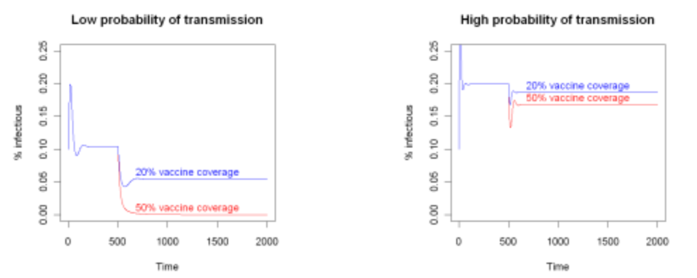

One-way and Multi-way Sensitivity Analysis
Example: SIR model with vaccination introduced at $t=500$. Increasing vaccine coverage from 20% to 50% makes a much bigger difference on prevalence when the probability of transmission is low.
Notes:
“How sensitive the proportion of the population that is infected (i.e. the prevalence of infection) at equilibrium is to vaccine coverage?”
Let’s consider the difference between 20% and 50% vaccine coverage. Clearly at 50% coverage, the infectious equilibrium will be lower than at 20% coverage.
But “how much lower?” depends on the probability of transmission.
If the transmission probability is low, then increasing coverage will have a large effect on the infectious equilibrium,
but if the transmission probability is high, then increasing coverage will have a smaller effect.
Hence we see that we can’t determine how sensitive the model is to vaccine coverage without knowing what is happening to other parameters, such as the probability of transmission.
That’s the weakness of one-way sensitivity analysis – many models become more sensitive to certain parameters when other parameters take particular values.
Hence we have to evaluate sensitivity to all the parameters at the same time, not just one at a time.

Slide 6
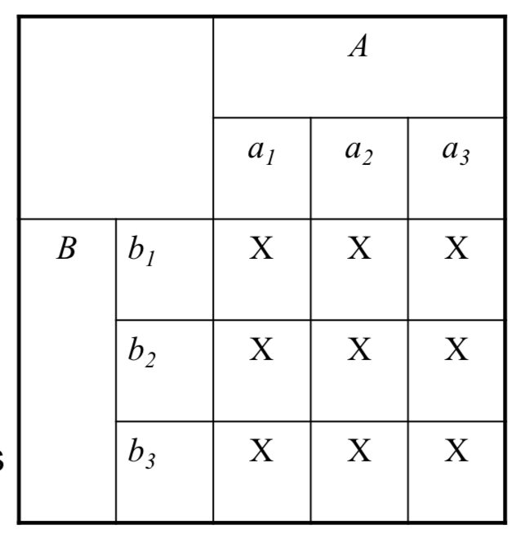

Grid Search
Systematically search the joint parameter space of all relevant parameters and evaluate the result at each combination of parameters
For two parameters ($A$ and $B$) with 3 values each, we need to sample $3^{2}=9$ parameter sets
If number of parameters or number of values for each parameter is large then grid search becomes unfeasible e.g. 5 parameters & 10 values → 100,000 sets

Slide 7
Random Sampling (Monte Carlo Sampling)
Probabilistic sensitivity analysis
Pick a value for each parameter we are uncertain about from some distribution e.g. pick 𝐴 and 𝐵 uniformly from the range 0.01~0.5
Evaluate the outcome measure by solving the model for that set of parameters
Repeat this process many times (e.g. 100,000)

Slide 8
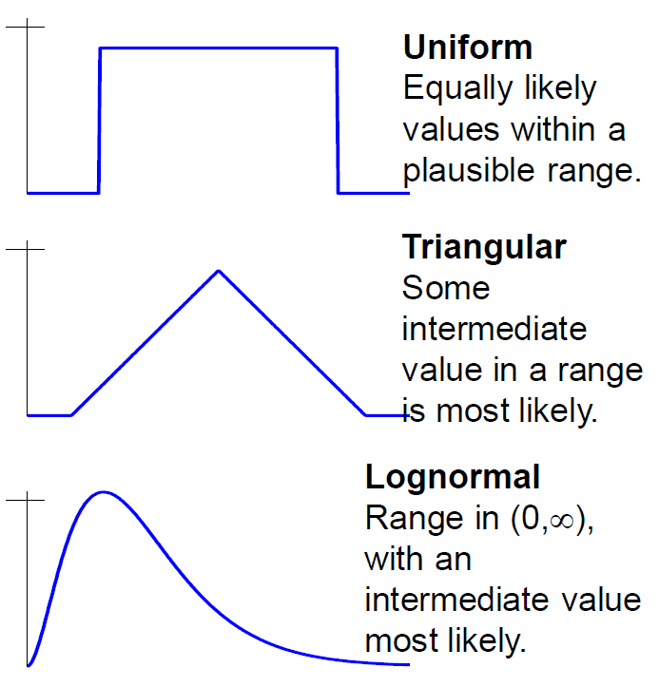
Random Sampling
How do we choose appropriate probability distributions for each parameter?
Epidemiological studies
Synthesis (e.g. meta-analysis)
of available data
Expert elicitation
⋇ The probability distribution of a parameter should represent the uncertainty around that parameter rather than the variability
Uncertainty – Lack of knowledge about a quantity, which can be reduced by further study (e.g. taking a larger sample)
Variability – Heterogeneity between individuals, which is inherent in the population and will not be reduced by further study
Notes:
One advantage of probabilistic sensitivity analysis is that it allows us to choose appropriate probability distributions for each parameter,
which can reflect our belief about how likely it is that a parameter will take certain values.
For instance, suppose we wanted to estimate the mean height of everyone in this class.
If we measured everyone’s height precisely and took the mean, there would be no uncertainty in our estimate of the mean
(since we were able to include every single member of the population), but a lot of variability.
On the other hand, if we only sampled two individuals from this class and they both had a height of 1.7 meters,
there would be no variability in our estimate but a great deal of uncertainty.

Slide 9


Random Sampling
If we sample completely at random from the probability distribution of each parameter, the method is inefficient as it doesn’t ensure full coverage of parameter space and we may get clusters of points
$$A$$
 |  | X |  |  | X |  |  |  | X
 |  |  |  |  |  |  |  | X
 |  | X | X
 |  |  |  |  |  | X
 |  |  | X |  |  |  |  | X
 |  |  |  |  |  |  |  | X
$$B$$
Random sample for two parameters

Slide 10
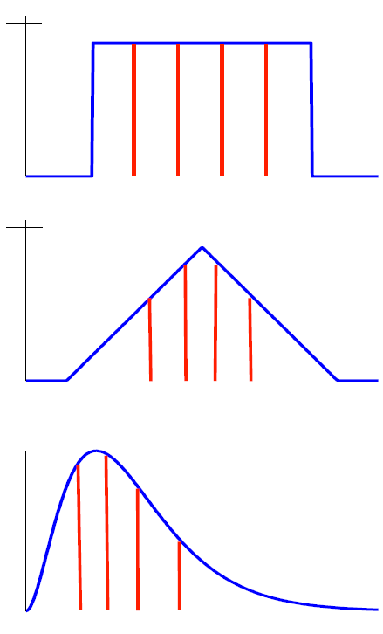
Latin Hypercube Sampling
A more efficient way to sample is Latin hypercube sampling:
Divide the probability distribution of each parameter into N equal probability sections
Sample each parameter from one of its available sections (without replacement)
Repeat until you have built up N equal parameter sets that together encompass all sections of all parameters

Slide 11




Latin Hypercube Sampling
The values chosen are more evenly distributed than in a simple random Monte Carlo sample
$$A$$
$$A$$
 |  | X |  |  | X |  |  |  | X
 |  |  |  |  |  |  |  | X
 |  | X | X
 |  |  |  |  |  | X
 |  |  | X |  |  |  |  | X
 |  |  |  |  |  |  |  | X
 |  |  |  | X
 |  |  |  |  |  | X
 |  |  |  |  |  |  |  |  | X
 |  |  | X
X
 |  | X
 |  |  |  |  | X
 |  |  |  |  |  |  |  | X
 | X
 |  |  |  |  |  |  | X
$$B$$
$$B$$
Random sample
Latin hypercube sample

Slide 12
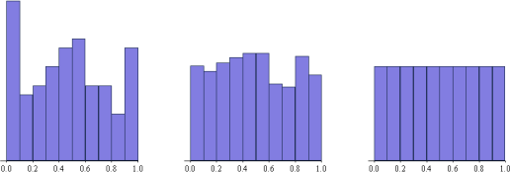
Latin Hypercube Sampling
Samples from uniform distribution on (0, 1)
Random sample of 100
Random sample of 1000
Latin hypercube sample of 100

Slide 13
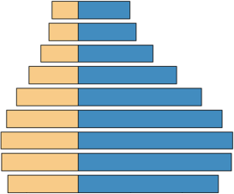
Representing results: Tornado graph
Tornado graph shows how the outcome variable varies as each input variable is varied
Variable 1
Less influential variable
Variable 2
Variable 3
Variable 4
Variable 5
Variable 6
Highly influential variable
Variable 7
Variable 8
Variable 9
Mean (or Median)
Outcome variable
Notes:
One-way sensitivity analysis
Vary each input parameter within a certain range, and record how the output variable changes
Multi-way sensitivity analysis
Construct a statistical (e.g. linear) model of the association between the outcome variable and each of the input parameter, parameterized using the sampled parameter sets.
Now vary each input parameter within its range in the model.

Slide 14



Representing results: Multi-way Sensitivity
Example: SIRS model (e.g. pertussis)
$$β$$
$$r$$
S
Susceptible
I
Infectious
R
Recovered
$$w$$
Comparing the effect of $β$ for two different values of $r$
Notes:
In multi-way sensitivity analysis, the influence a parameter has on the outcome depends not only on how it is varied, but also on how all the other parameters are varied

Slide 15
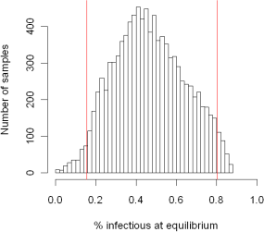

Representing results: Histogram
To investigate the joint effect of varying the parameters,
sample $β\sim \text{U} [0.1, 0.9]$, $r\sim \text{U} [0.01, 0.09]$, $w\sim \text{U} [0.01, 0.09]$
95% uncertainty interval is (0.16, 0.80)
Histogram showing the distribution of outcome values across 10,000 samples
Notes:
For instance, suppose for 2.5% of simulations the outcome $Y$ is below $Y_{1}$ and for 2.5% it is above $Y_{2}$.
Then ($Y_{1},Y_{2})$ is a 95% uncertainty interval for $Y$.

Slide 16
Representing results: Statistical model
Construct a statistical (e.g. linear) model of the association between the outcome variable and each of the input parameters, parameterized using the sampled parameter sets.
$$y_{i} \sim c_{1}β_{i}+c_{2}r_{i}+c_{3}w_{i}+ε_{i} (i=1,…,10000)$$
% infected at equilibrium
Input parameters
Error
Coefficient | Estimate | Standard Error | t-value | P-value
Intercept | 0.486526 | 0.001859 | 261.7 | <0.001
c₁ | 0.208670 | 0.002075 | 100.6 | <0.001
c₂ | -5.940816 | 0.020759 | -286.2 | <0.001
c₃ | 3.485241 | 0.020783 | 167.7 | <0.001

Slide 17
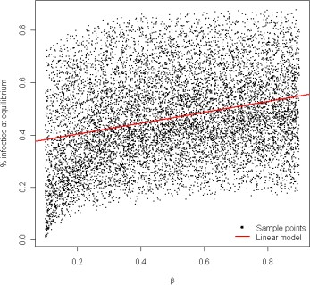
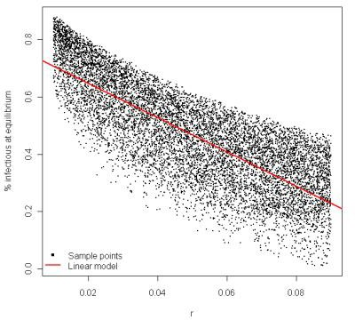


Representing results: Statistical model
Marginal effect of $β$: use the linear regression model, and assume that $r$ and $w$ are held constant and take their mean values
The linear model predicts the average % infectious at equilibrium for different values of $β$ when $γ$, $w$ are sampled over their entire distributions

Slide 18
Other Sources of Uncertainty
Model structure: you could build SIS, SIR and SIRS models and see how outcomes change across different structural choices
Type of model: how outcomes may change if you used a stochastic model instead of a deterministic model
Initial conditions: unlikely to be important for deterministic models that are run to endemic equilibrium. It is more important for stochastic low-prevalence
Bilcke J et al. Accounting for Methodological, Structural, and Parameter Uncertainty in Decision-Analytic Models: A Practical Guide. Med Decis Making 2011; 31(4): 675-92.

